Slide 1
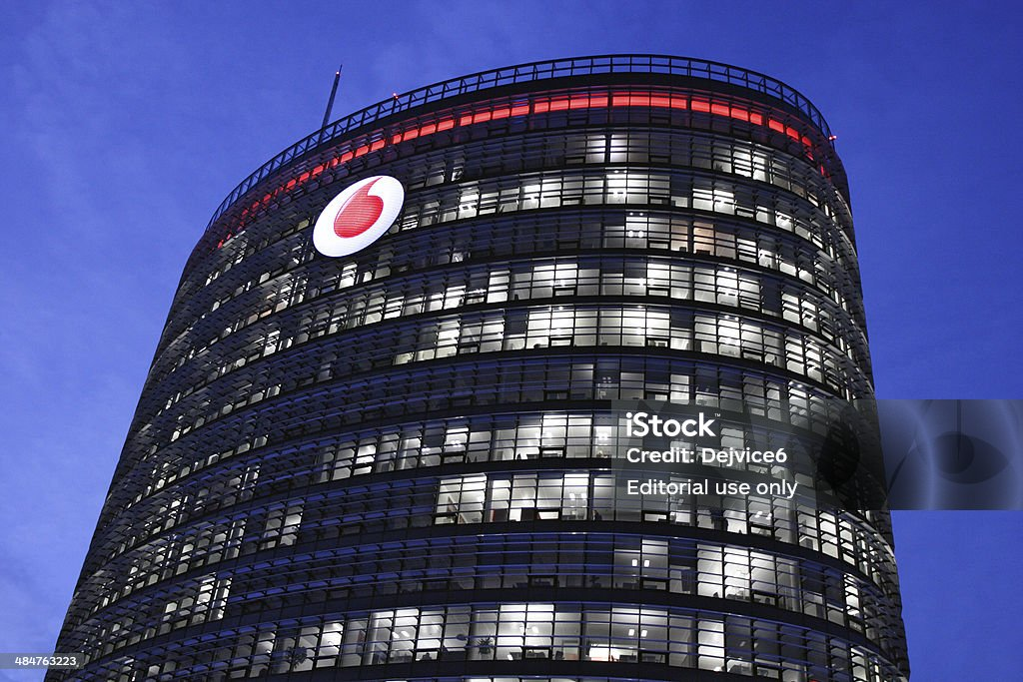
Decoding Student Retention and Churn Predictive Analytics of Vodafone(Telecel) in Knust

Slide 2

Introduction

Slide 3

Problem Statement

Slide 4

Research Objectives

Slide 5
Significance of the Study

Slide 6
Literature Review

Slide 7
Conceptual Framework

Slide 8


Slide 10
Summary

Slide 11

Thank You

